Slide 1
Jain College of Engineering, Belagavi Dept. of Electronics and Communication Final Project Phase
Title : Coal Mine Safety Monitoring and Alerting System with Smart Helmet
Students name and USN :
Basavaraj B. Gudasalamani – 2JI21EC030
Chetan A. Girigouda – 2JI21EC038
Girish I. Nadakattin – 2JI21EC051
Vishal S. Tikoti – 2JI21EC178
Guide Name :
Prof. Shivanand Channi

Slide 2
Table of Contents
Introduction
Problem Statement
Objectives
Methodology
Advantages / Disadvantages
Applications
References

Slide 3
Introduction:
The Smart Helmet for Coal Safety Monitoring and Alerting System is a cutting-edge solution designed to improve safety for miners in hazardous coal mining environments. This helmet features integrated sensors that monitor harmful gases, air quality, temperature, and humidity. It provides real-time alerts to the wearer personnel in case of dangerous conditions or health issues, facilitating quick responses. By continuously monitoring these critical parameters, the Smart Helmet significantly reduces risks, enhances miner safety, and contributes to a safer working environment in the coal mining industry.

Slide 4
Problem Statement:
Coal miners often work in hazardous environments with risks from toxic gases, extreme temperatures, and unsafe conditions. Existing safety measures lack real-time monitoring and immediate alerts for dangerous situations. This project proposes a Smart helmet with sensors to measure gas levels (MQ2 and MQ7), temperature, and humidity (DHT11), along with a buzzer and an LCD display. The helmet provides real-time environmental readings directly on the LCD and triggers a buzzer to alert miners when dangerous thresholds are exceeded, enhancing safety and reducing risks in coal mines.

Slide 5
Objectives:
Real-Time Monitoring: Continuously measure temperature, humidity, and gas concentrations in the mining environment.
Immediate Alerts: Trigger a buzzer to warn miners of dangerous conditions like toxic gas leaks or high temperatures.
Local Display: Show real-time readings on an LCD for quick and easy access.
Enhanced Safety: Provide a proactive safety solution to minimize accidents and health risks in coal mines.
Portability and Power Efficiency: Ensure the helmet is lightweight, battery-powered, and suitable for prolonged use underground.

Slide 6
Components Used
Arduino UNO
DHT11(Temperature sensor)
Mq2 (Flammable gas sensor)
MQ7 (CO)
16x2 LCD display
Buzzer
Battery (3.7V*2 power supply)
TP4056 (charging module)
Jumper wires
Breadboard
6

Slide 7
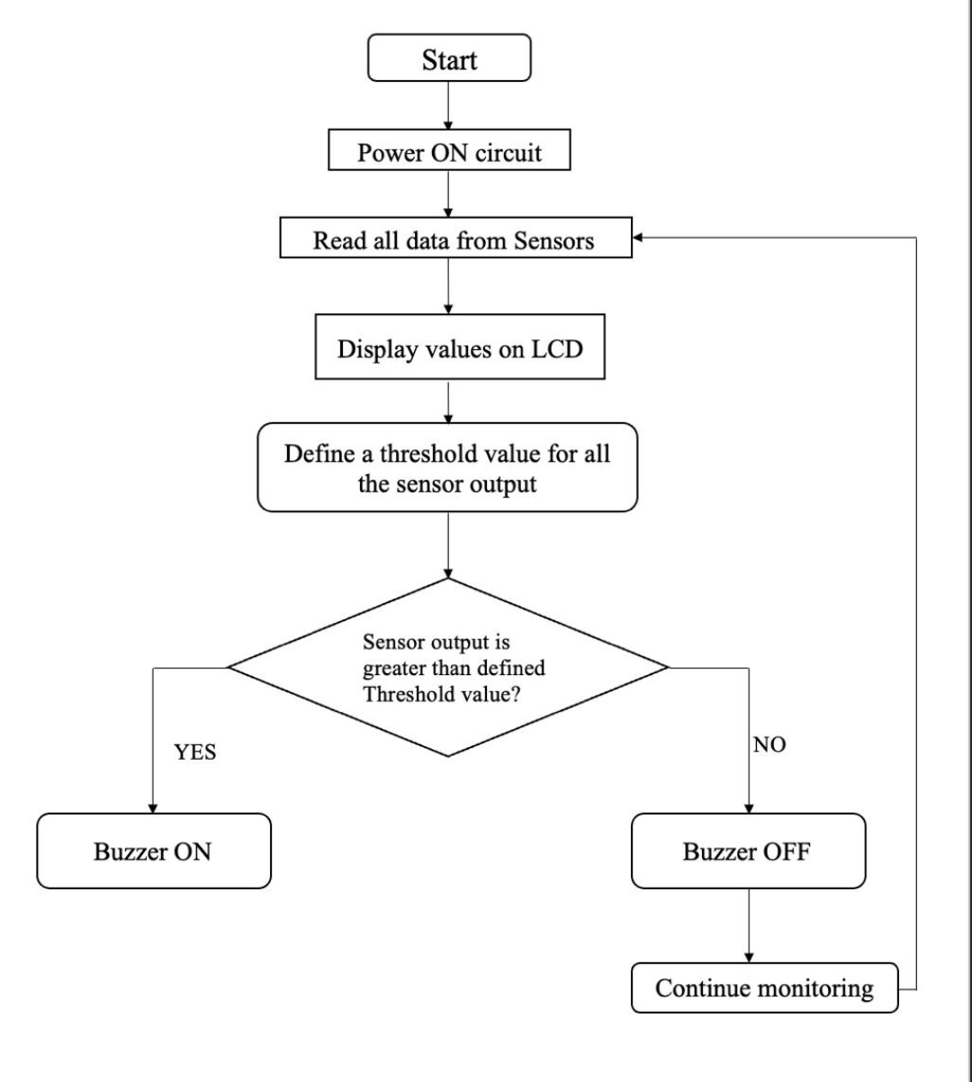
Methodology :

Slide 8
Advantages :
Enhanced Safety: Provides real-time monitoring of hazardous conditions to prevent accidents.
Immediate Alerts: Warns miners instantly with a buzzer for quick action.
Cost-Effective: Uses affordable components for economical implementation.
Disadvantages
Limited Range: Data is accessible only on-site without remote connectivity.
Power Dependency: Requires regular battery recharging to ensure functionality.
Sensor Maintenance: Sensors need periodic calibration for accurate readings.

Slide 9
Applications
Real-Time Environmental Monitoring: Constantly tracks air quality, temperature, humidity, and gas levels, providing immediate warnings to miners when unsafe conditions are detected.
Accident Prevention and Response: Detects hazardous events like gas leaks, high temperatures, and sudden drops in pressure, automatically alerting both miners and control rooms to enable fast evacuation or assistance
Health and Safety Management: Monitors miners' health metrics, such as heart rate and body temperature, to quickly identify any signs of distress or health issues, which is crucial in remote and underground mining environments.
Accident Alerts: Detects falls or sudden movements and sends alerts for quick assistance if a miner is injured.

Slide 10
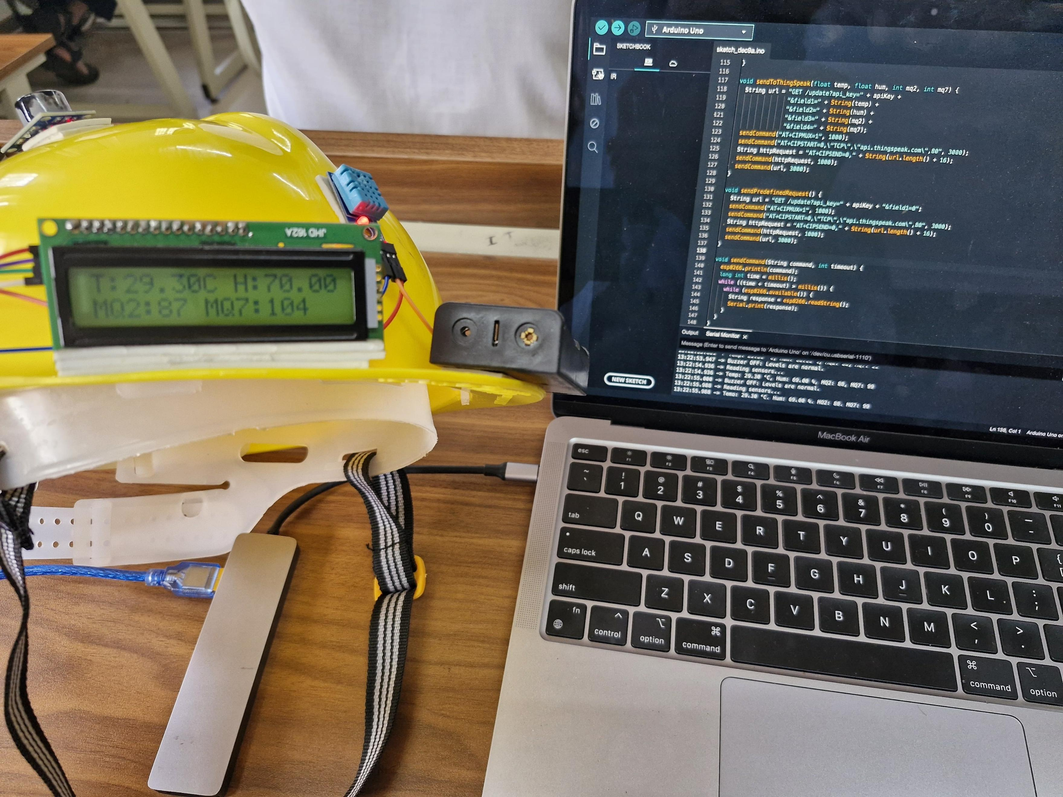
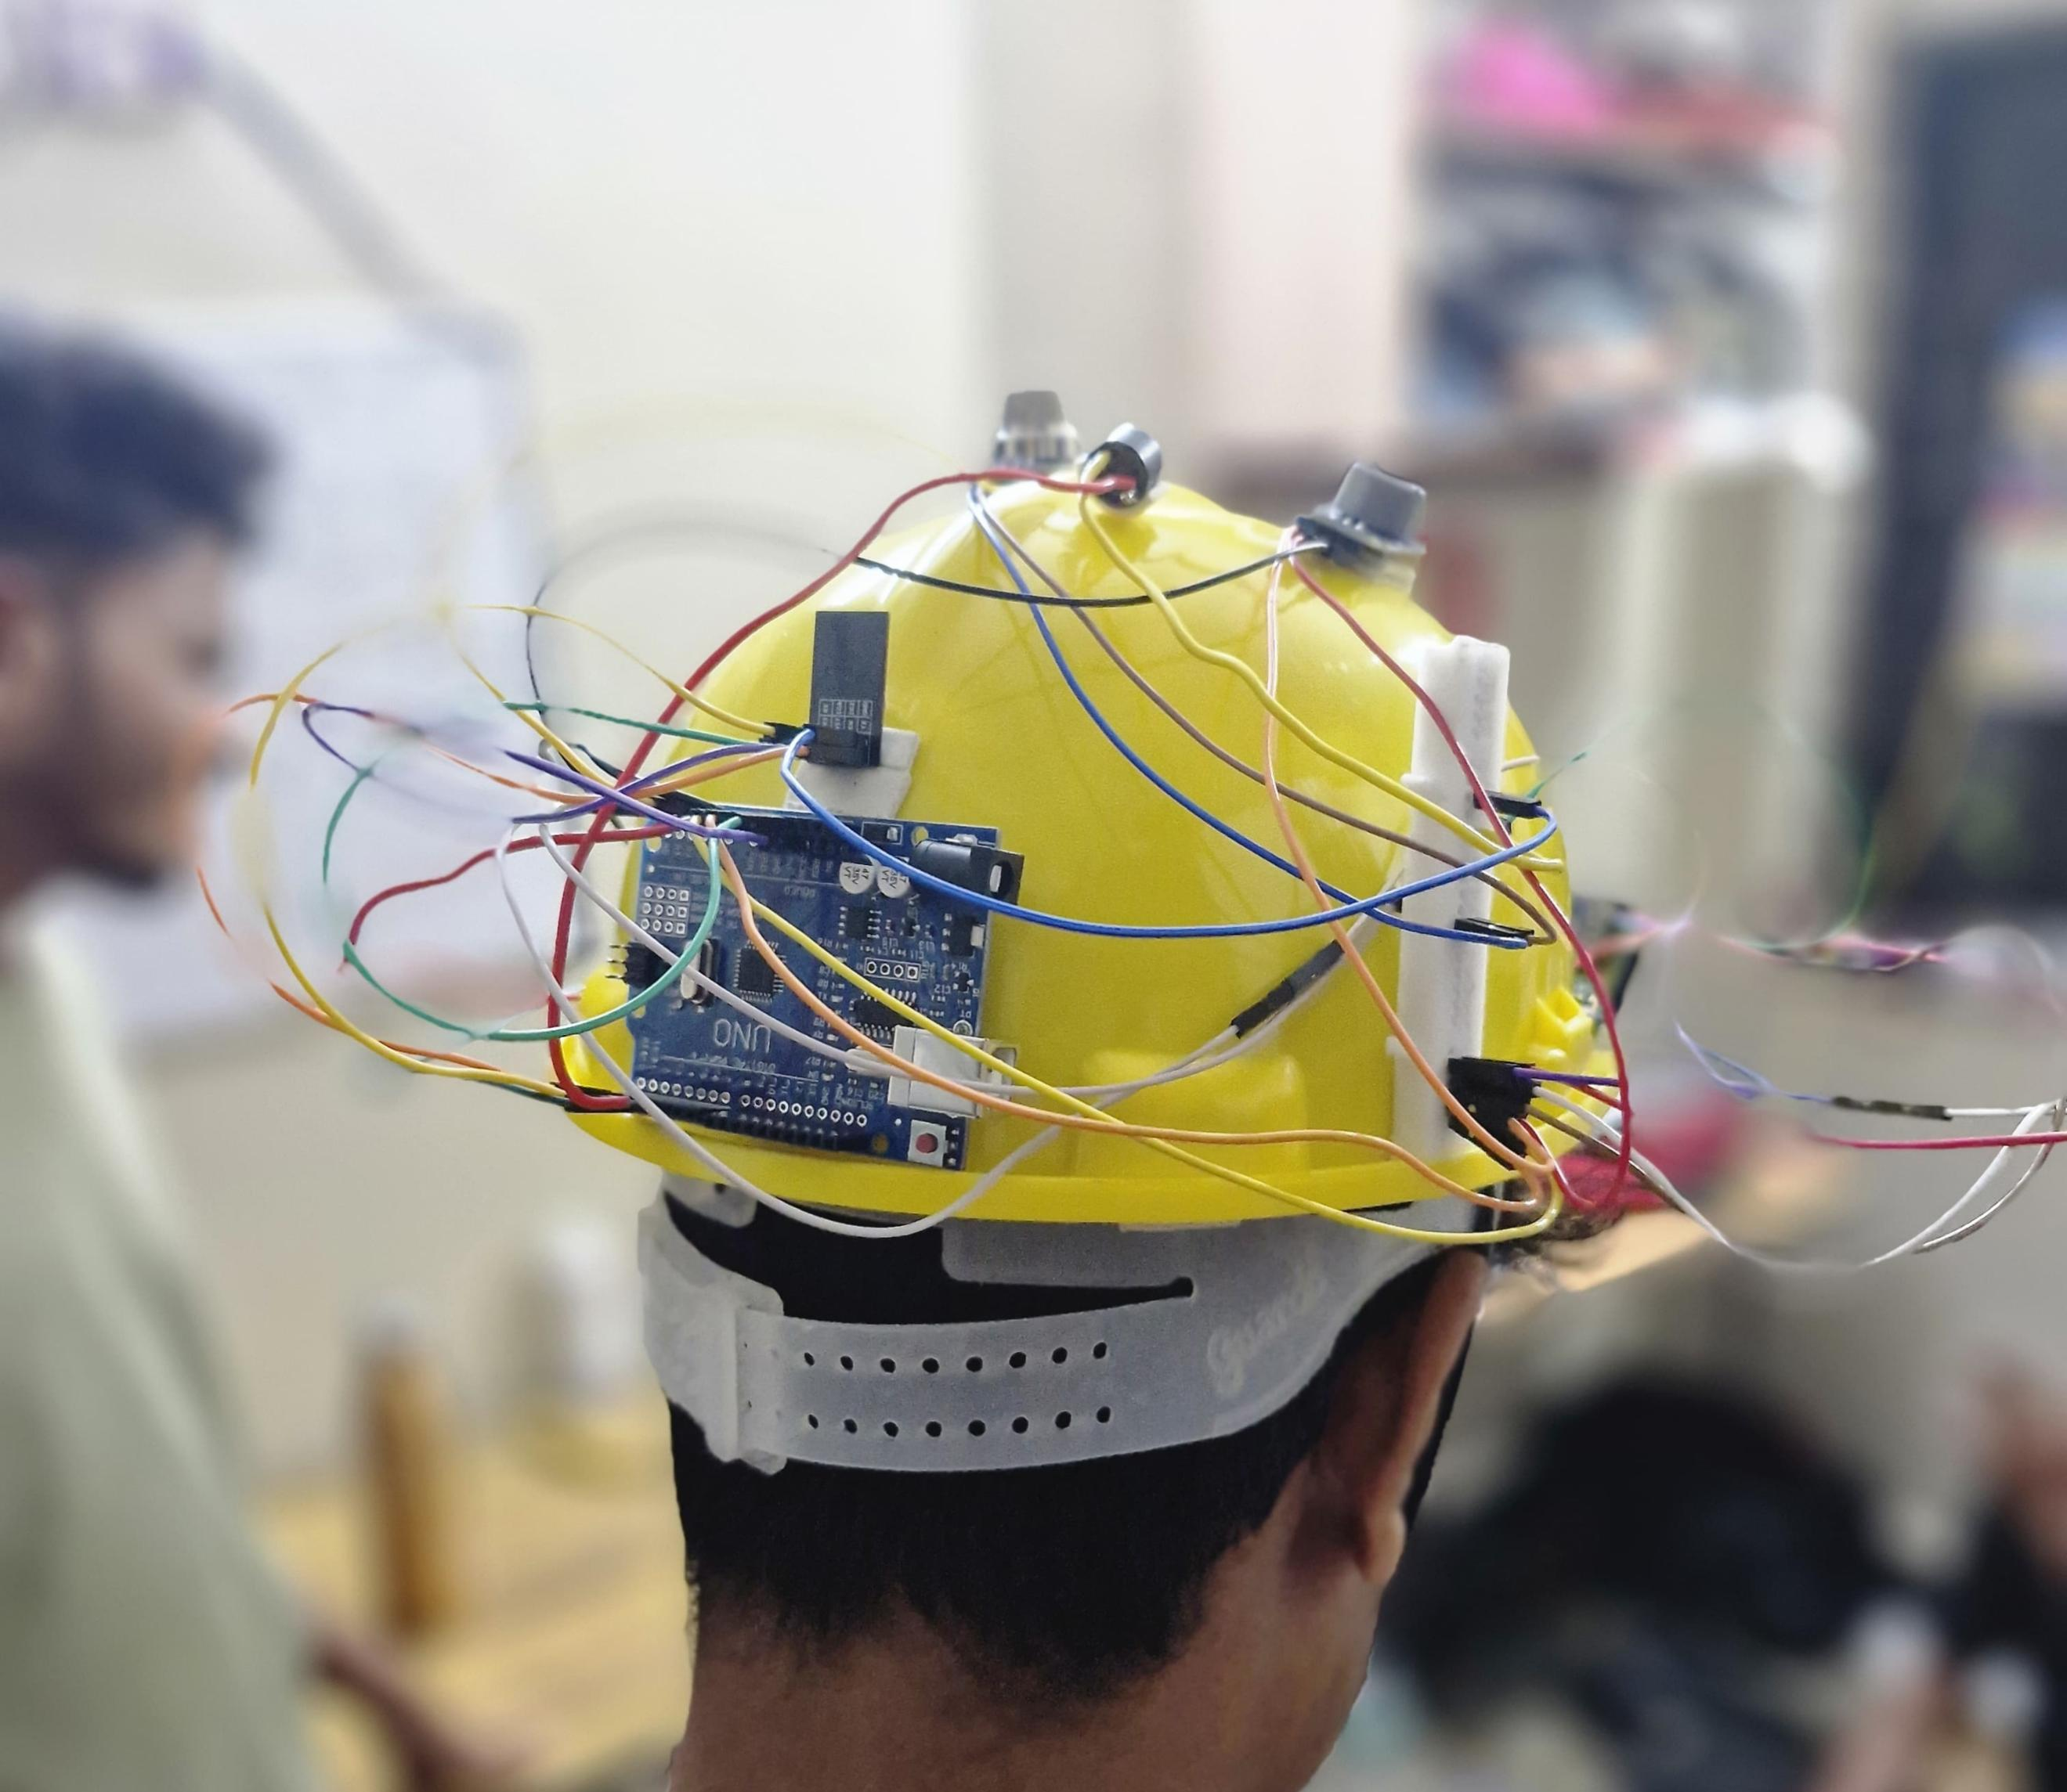
Final Output :

Slide 11
REFERENCES
Y. Shi, J. Chen, J. Hao, J. Bi, M. Qi and X. Wang, "Statistical Analysis of Coal Mine Accidents of China in 2018," 2019 Prognostics and System Health Management Conference (PHM-Qingdao), (2019).
Ericsson, M., Löf, O. Mining's contribution to national economies between 1996 and 2016.
Hong Chen, Hui Qi, Ruyin Long, Maolong Zhang, Research on 10-year tendency of China coal mine accidents and the characteristics of human factors, Safety Science, Volume 50, Issue 4, (2012).
Dennen, R S, and Stroud, W P. Radar hazard Detection in a coal structure. United States : N.p., (1991).
Hebblewhite, Bruce. (2009). Mine safety–through appropriate combination of technology and management practice. Procedia Earth and Planetary Science. 1. 13-19.10.1016/j.proeps.2009.09.005, (2009).
T. Liu et al., "Advances of optical fiber sensors for coal mine safety monitoring applications," 2013 International Conference on Microwave and Photonics (ICMAP), (2013).
Jiang Y, Li Z, Yang G, Zhang Y, Zhang X. Recent progress on smart mining in China: Unmanned electric locomotive. Advances in Mechanical Engineering. March 2017.R. K. Kodali, T. Devi B. and S. C. Rajanarayanan, "IOT Based Automatic LPG Gas Booking and Leakage Detection System," 2019 11th International Conference on Advanced Computing (ICoAC),(2019).

